Slide 1
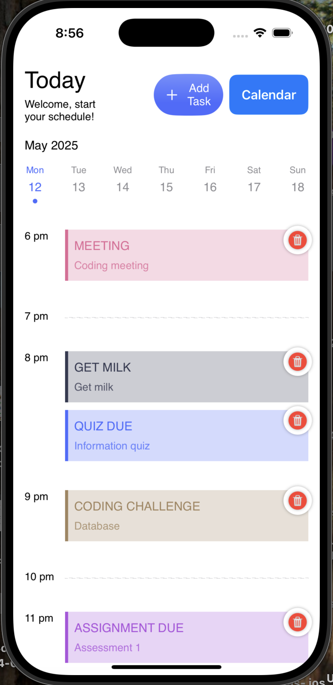
TO DO List APP
Crace Cen, Margarita Dowd, Zhongying Yuan
Tutor: Mathew Backwood
Tutorial Time: Tuesday 13:30

Slide 2


Target Audience
Our primary users are university students who face multiple academic and personal responsibility.
These users often struggle with the time management, overlapping deadlines and forgetting tasks due to busy schedules.
Zhongying Yuan

Slide 3
To -Do List for University Students
Problem Being Solved
Students lack a simple, focused tool to help track assignments, tasks.
Paper planners or complex apps can be overwhelming. The app provides a clean , minimal solution.
Comparison to Other Solutions
Simpler and more focused on the students’ needs.
A student-friendly UI, emphasizing ease of use.
Allows quick task creation with minimal setup.
Zhongying Yuan

Slide 4
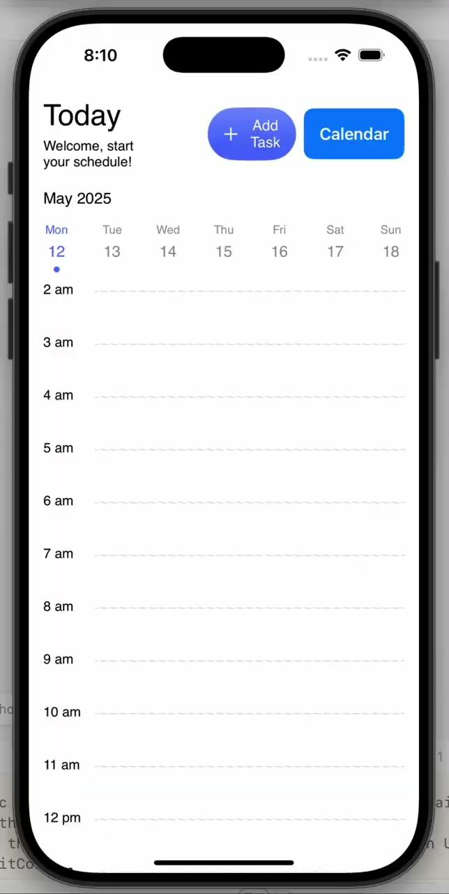
Demonstration
Grace

Slide 5
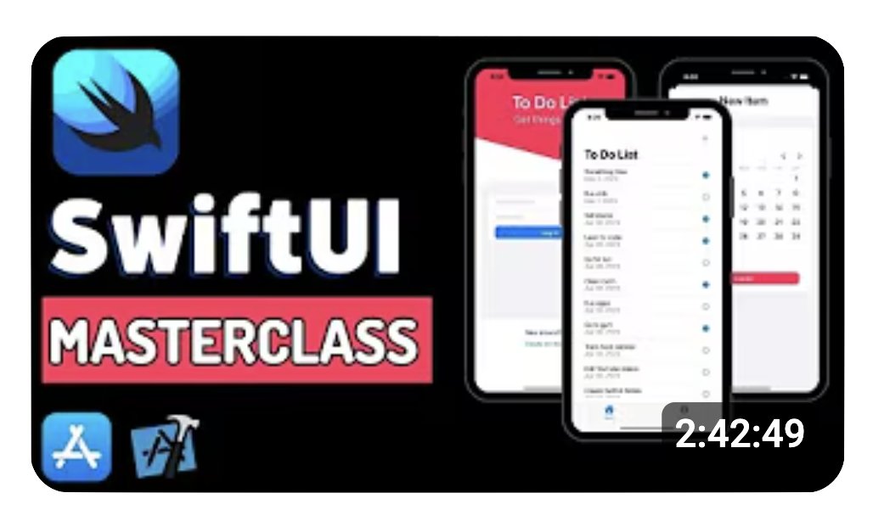
Frameworks/Services
Initially we used Firebase API for our app but due to some errors we decided not to use it.
Using dynamic time components in SwiftUI
Using online videos to help with our app

Slide 6
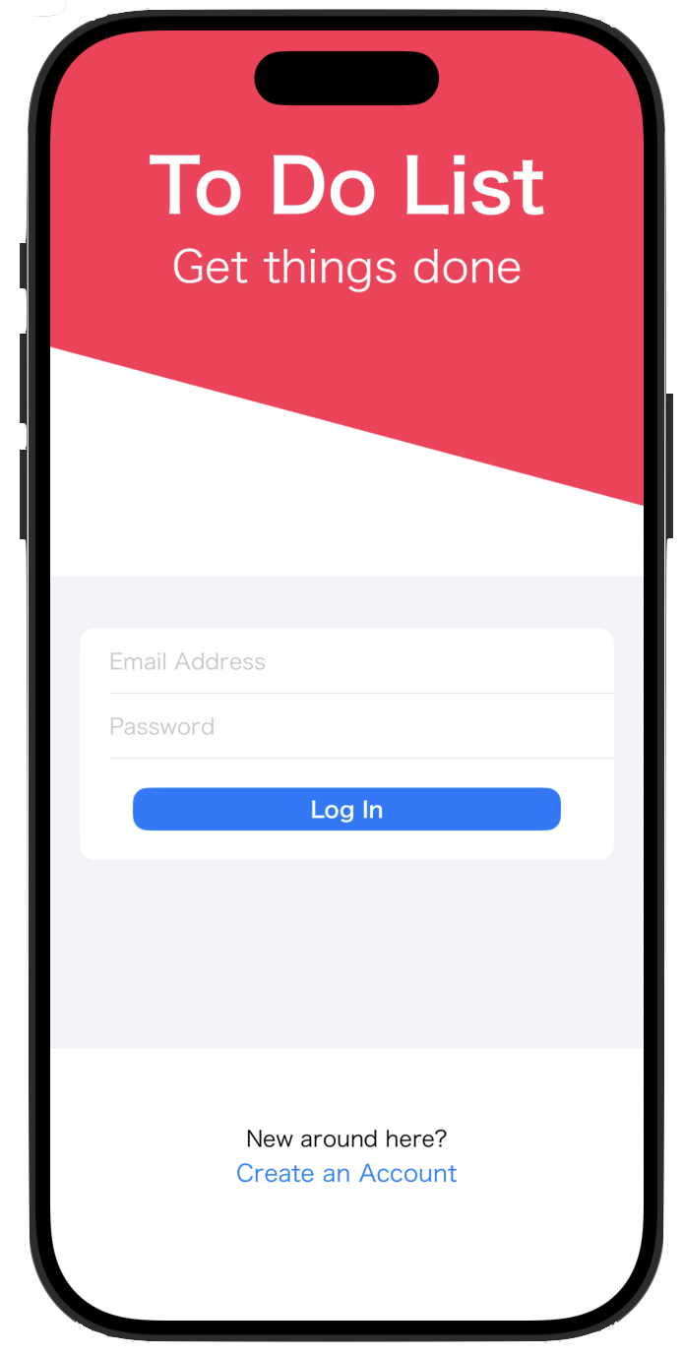
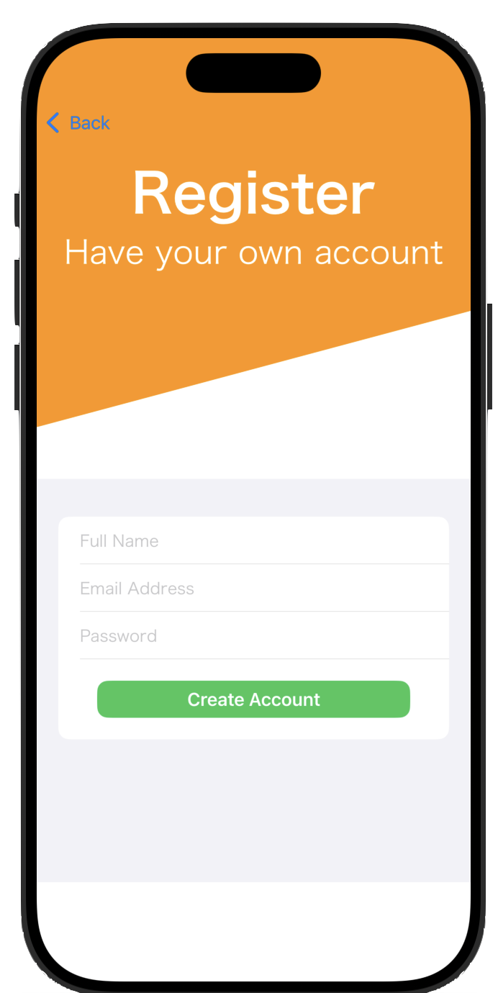
Greatest Difficulty
Problem
Initially included login/profile system using FirebaseFirestoreSwift
Library was discontinued → caused major compatibility issues
Login required physical device (due to chip/token check) → made testing hard
Prototype became inaccessible without login
Solution
Removed login functionality to allow open access to all users
Refocused on main features like calendar and task management

Slide 7
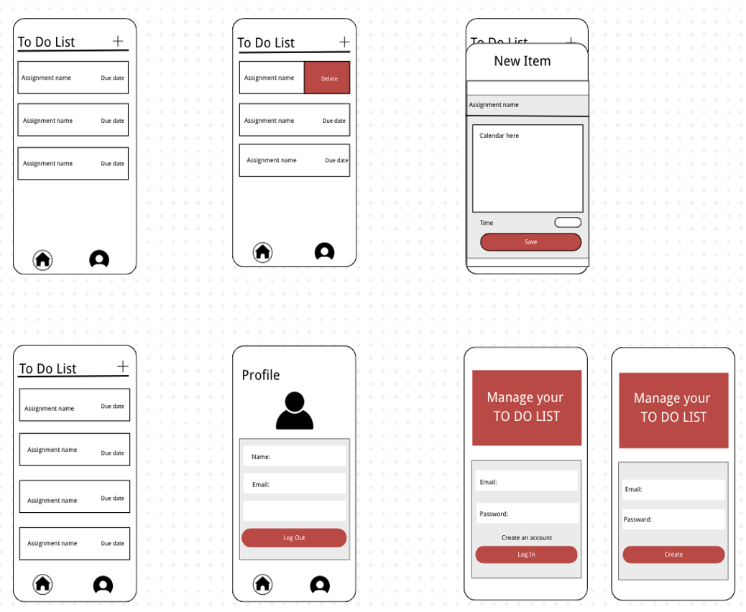
Iterative Product Design
Initial idea (Login + Profile) → Built and tested with Firebase authentication.
Found blockers → Login required a physical device + deprecated library.
Re-evaluated and changed direction → Dropped login feature to prioritize functionality and accessibility.
Redesigned and redeveloped → Focused on core features: calendar and task system.
Tested again → Got feedback, improved UI, and fixed smaller bugs.
Each cycle brought the prototype closer to the MVP → Final version is simpler, faster, and works for all testers.

Slide 8
Thank you

